Slide 1
Threading
Servlets Can handle multiple clients concurrently
Shared resources must be synchronized
or create a servlet that handles one request at a time with SingleThreadModel
public class ReceiptServlet extends HttpServlet
implements SingleThreadModel {
public void doPost(HttpServletRequest request,
HttpServletResponse response)
throws ServletException, IOException {
... } ... }

Slide 2
Running Servlets
JSDK2.1
default.cfg : Web Server configuration information
batch files to startserver and stopserver
Servlet properties in <install_dir>/webpages/WEB-INF directory

Slide 3
Other Details
Servlet directory is doc_root/WEB-INF/servlets
Default doc_root is webpages subdirectory of install directory
servlets.properties: properties for all servlets that servlet running utility will run

Slide 4
Properties 2.1
Key-value pairs
Class name of servlet (name.code): Name is key, value is full class name (including package)
catalog.code = examples.bookstore.CatalogServlet
Intialization Parameters (name.initParams): parameterName=parameterValue

Slide 5
# This file contains the properties for the Duke's Bookstore servlets.
# Duke's Book Store -- main page
bookstore.code=BookStoreServlet
# View all the books in the bookstore
catalog.code=CatalogServlet
# Show information about a specific book
bookdetails.code=BookDetailServlet
# See the books that you've chosen to buy
showcart.code=ShowCartServlet
# Collects information for buying the chosen books
cashier.code=CashierServlet
# Provide a receipt to the user who's bought books
receipt.code=ReceiptServlet

Slide 6
Accessing Servlet Properties
name.initParams holds servlet initialization properties
access with with getInitParameters(“”)
servlet.bookdb.initArgs=\ mainFile=examples/bookstore/Bookstore.html

Slide 7
Access from servlet with getInitParameters(“”)
bookdetails.initParams=\
user=duke,\
password=dukes_password,\
url=fill_in_the_database_url

Slide 8
Running Servlets
From Browser: http://machine-name:port/servlet/servlet-name
name from properties
Can contain queries: http://localhost:8080/servlet/bookdetails?bookId=203

Slide 9
public class ShowCartServlet extends HttpServlet {
public void doGet (HttpServletRequest request,
HttpServletResponse response)
throws ServletException, IOException
{
...
out.println(... +
"<a href=\"" +
response.encodeUrl("/servlet/cashier") +
"\">Check Out</a> " +
...);
...
}
...
}
<a href="http://localhost:8080/servlet/cashier>Check Out</a>

Slide 10
      encodeURL
public java.lang.String encodeURL(java.lang.String url)
  Encodes the specified URL by including the session ID in it, or, if encoding is not needed,
  returns the URL unchanged. The implementation of this method should include the logic to
  determine whether the session ID needs to be encoded in the URL. For example, if the
  browser supports cookies, or session tracking is turned off, URL encoding is unnecessary.
  All URLs emitted by a Servlet should be run through this method. Otherwise, URL
  rewriting cannot be used with browsers which do not support cookies.
Parameters:
  url - the url to be encoded.
Returns:
  the encoded URL if encoding is needed; the unchanged URL otherwise.

Slide 11
Servlet Life Cycle
Server loads and initializes servlet
servlet handles client requests
server removes servlet
Servlet can remain loaded to handle additional requests
Incur startup costs only once

Slide 12
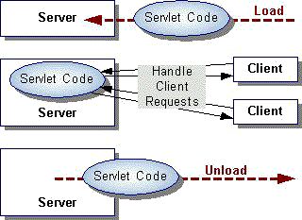

Slide 13
Servlet Initialization and Destruction
Servlet’s init() method
Create I/O intensive resources (database)
Initialization parameters are server specific
Seen in servletrunner properties file
destroy() method
make sure all service threads complete

Slide 14
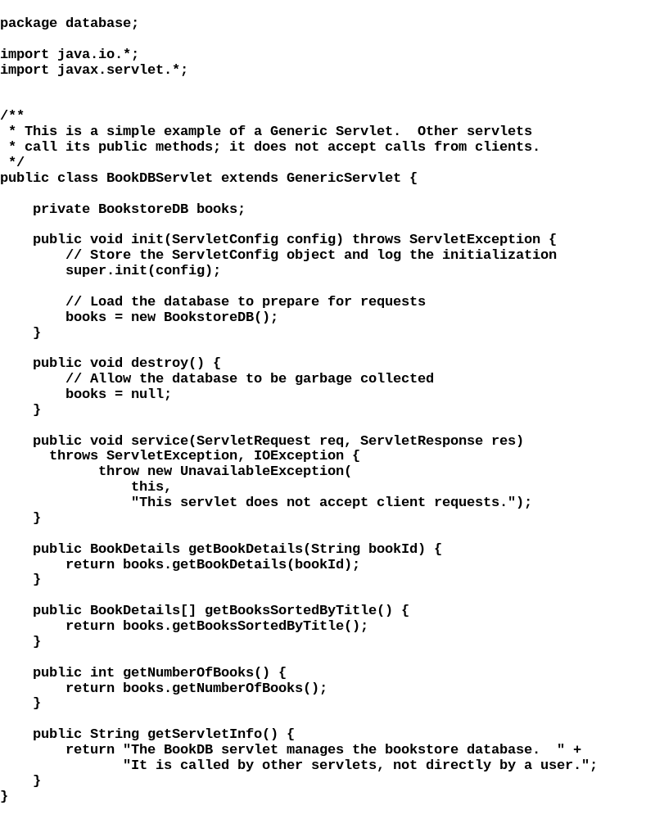

Slide 15
Servlet Threads
Service method for each client request
Server usually only calls destroy() after all service threads complete
Keep track of threads currently running
Wait for long-running threads to complete
Have long-running threads poll for shutdown

Slide 16
Include field that tracks service methods running
    public ShutdownExample extends HttpServlet {
    private int serviceCounter = 0;
    ...
    //Access methods for serviceCounter
    protected synchronized void enteringServiceMethod() {
    serviceCounter++;
    }
    protected synchronized void leavingServiceMethod() {
    serviceCounter--;
    }
    protected synchronized int numServices() {
    return serviceCounter;
    }
    }

Slide 17
Service method should keep count -- override service method--
call super.service() for HttpServlet
protected void service(HttpServletRequest req,
HttpServletResponse resp)
throws ServletException, IOException
{
enteringServiceMethod();
try {
super.service(req, resp);
} finally {
leavingServiceMethod();
}
}

Slide 18
Clean shutdown by checking service counter--
Notify long-runners of shutdown
public ShutdownExample extends HttpServlet {
private boolean shuttingDown;
...
//Access methods for shuttingDown
protected setShuttingDown(boolean flag) {
shuttingDown = flag;
}
protected boolean isShuttingDown() {
return shuttingDown;
}
}

Slide 19
Example Destroy Method
public void destroy() {
/* Check to see whether there are still
service methods running,
* and if there are, tell them to stop. */
if (numServices() > 0) {
setShuttingDown(true);
}
/* Wait for the service methods to stop. */
while(numServices() > 0) {
try {
Thread.sleep(interval);
} catch (InterruptedException e) {
}
}
}

Slide 20
Polite Methods
public void doPost(...) {
...
for(i = 0; ((i < lotsOfStuffToDo)
&& !isShuttingDown()); i++) {
try {
partOfLongRunningOperation(i);
} catch (InterruptedException e) {
}
}
}

